Slide 1
League of Legends Overlay Assistant
Midterm Report
Xihao Zhou
Bo Yang
Hao Yang
Ziheng Gong

Slide 2
Function Design
Champion Ban/Pick Tool
In Game Item Build Tool

Slide 3
Report catalog
Data crawling
Model introduction & Demo
Future steps

Slide 4
Data Crawling
Champions Build
Top Players Game Records (Build Sequence)

Slide 5
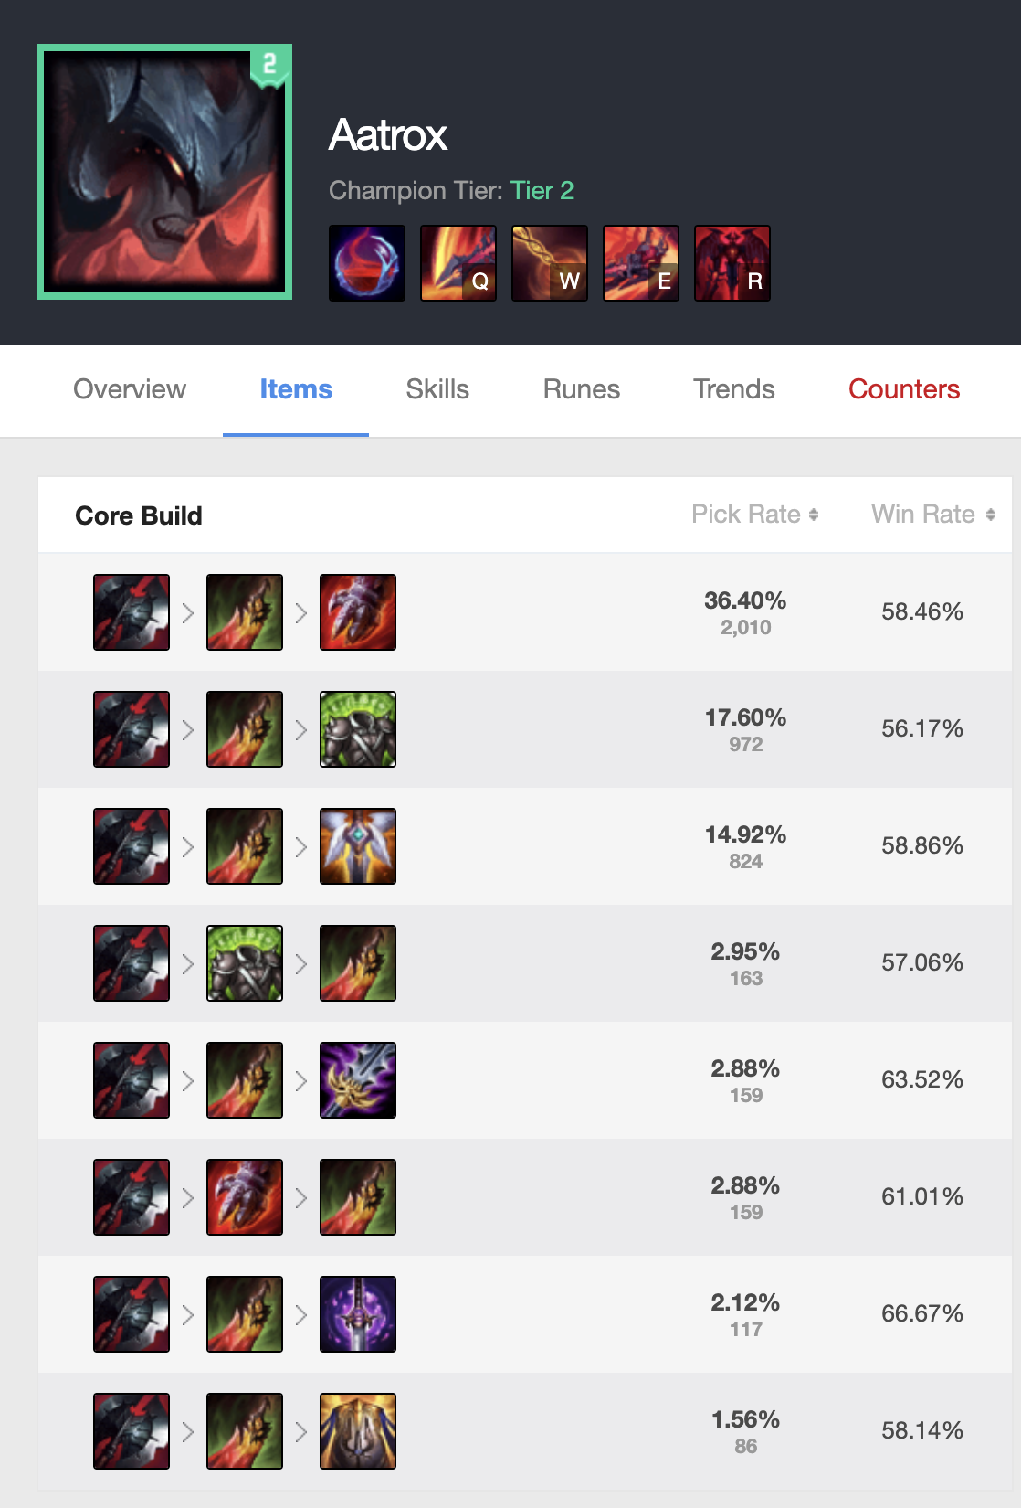
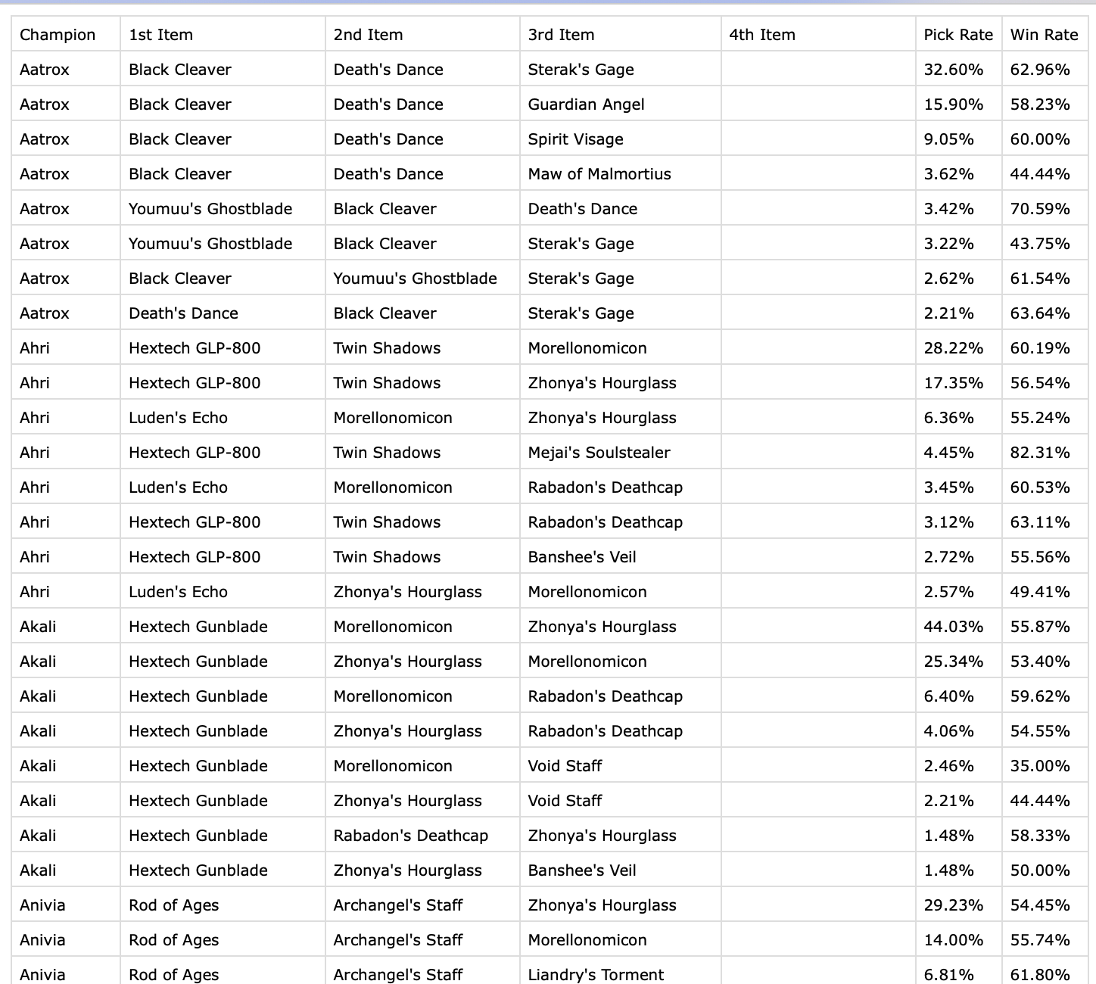
Champions Build Sequence
Total 148 Champions
Divided into Top, Mid, Bottom, Jungle, Support, 5 groups

Slide 6
Champions Build Sequence

Slide 7
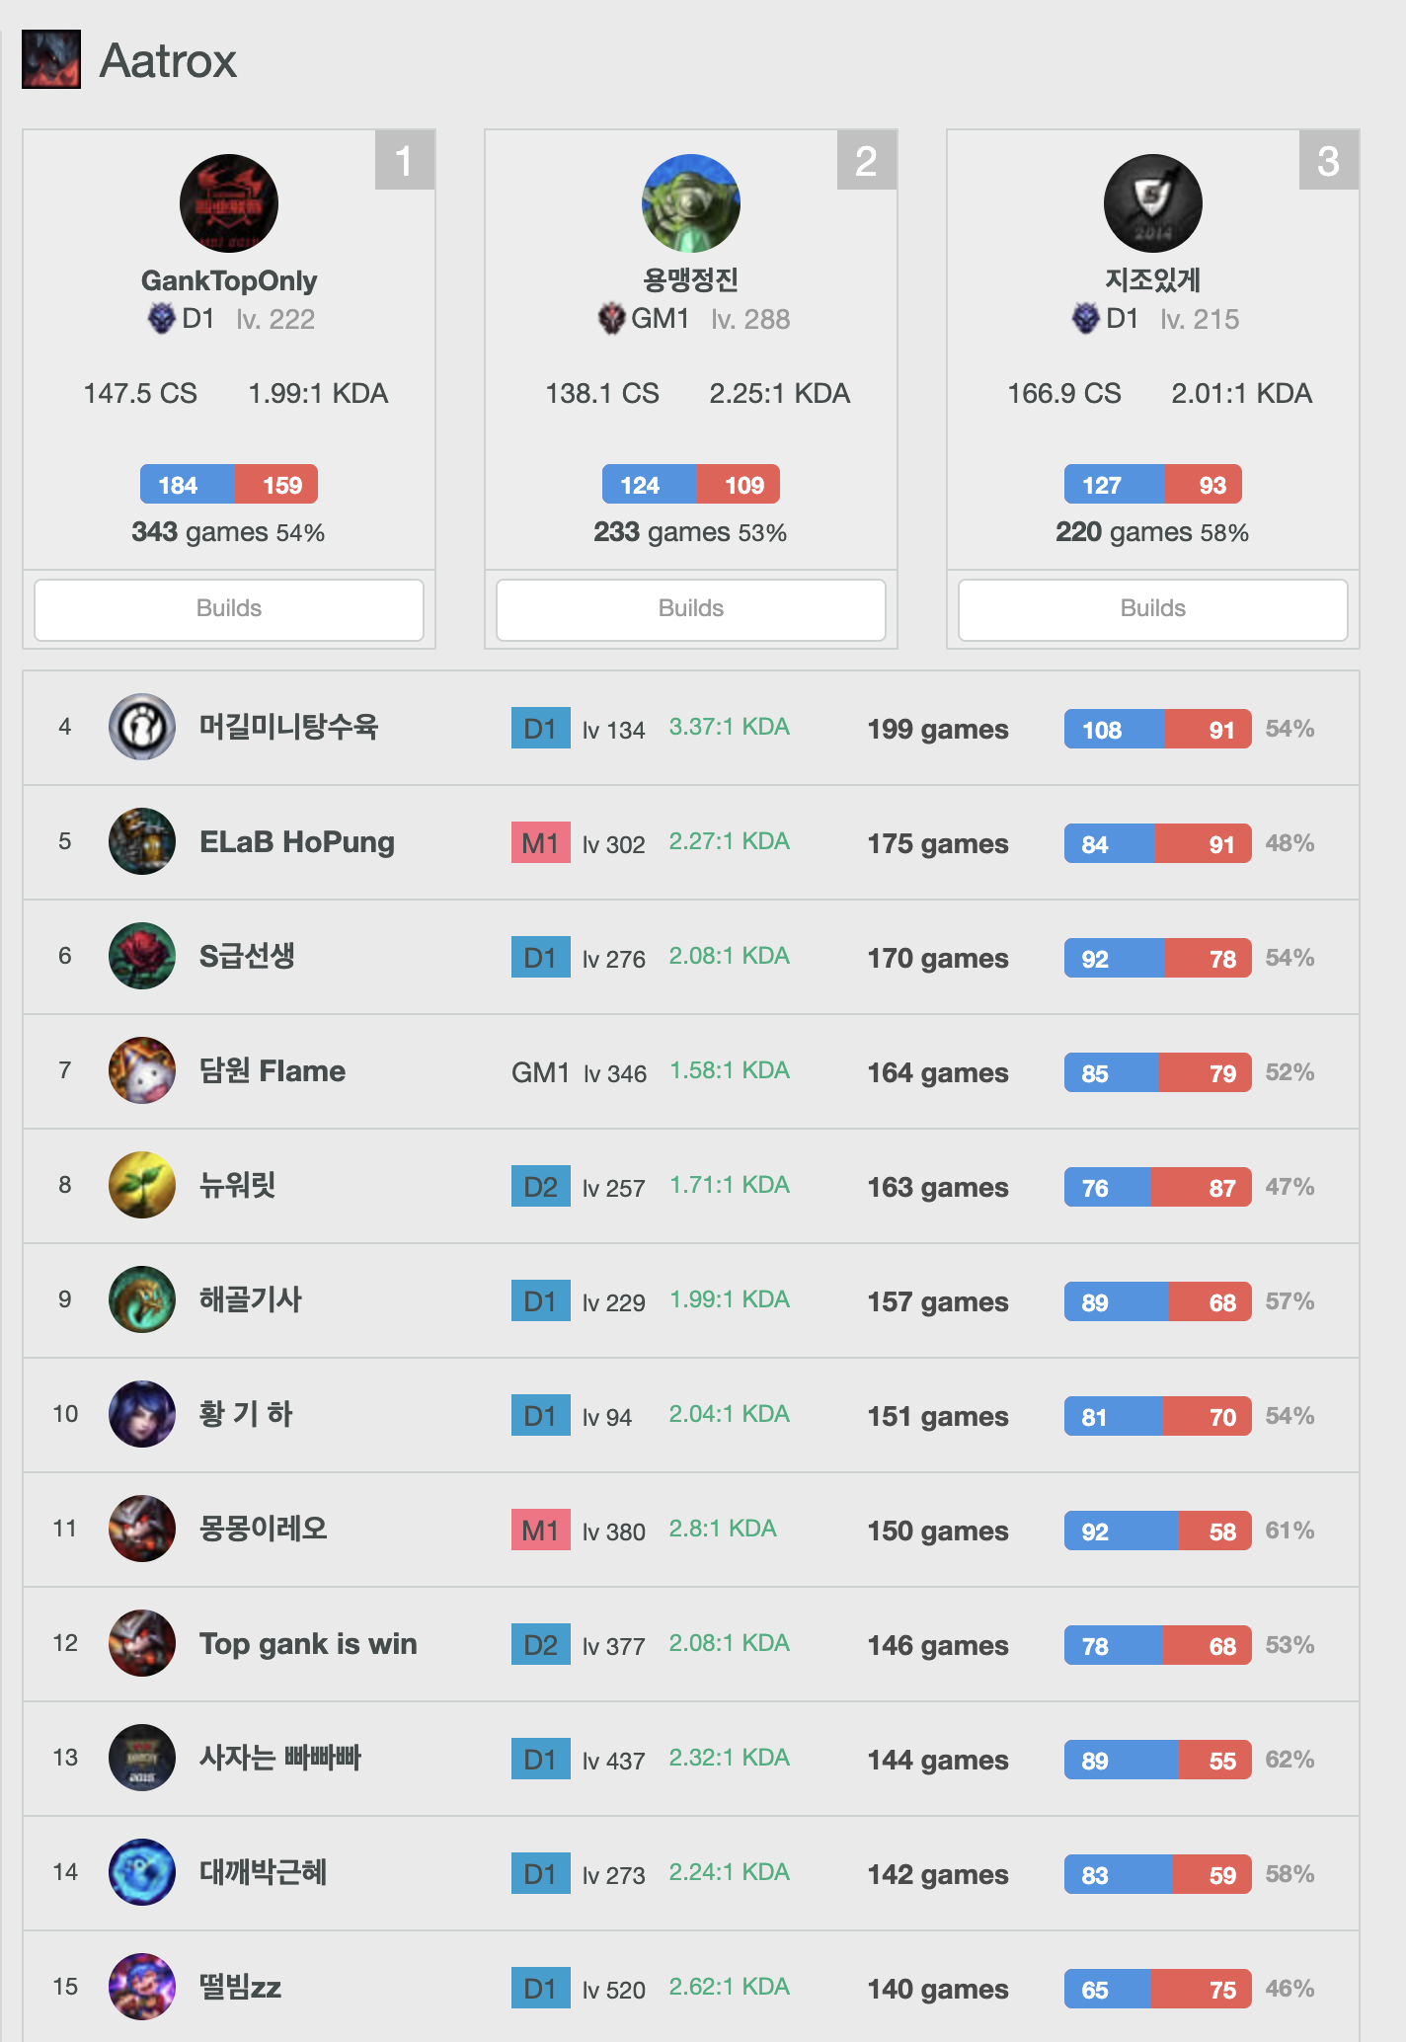
Top Players Game Records (Build Sequence)

Slide 8
Top Players Game Records (Build Sequence)
45 players for each champion.
About 300 matches each player.
In total - approximately 1900000 item build sequence

Slide 9
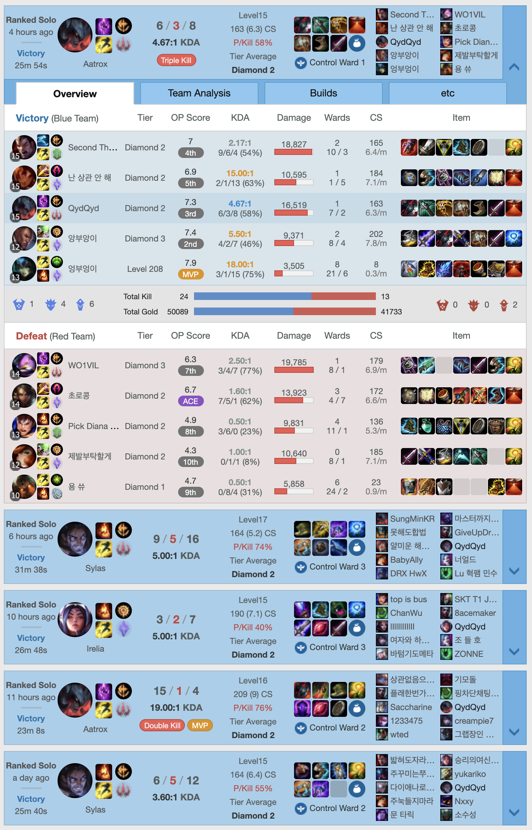
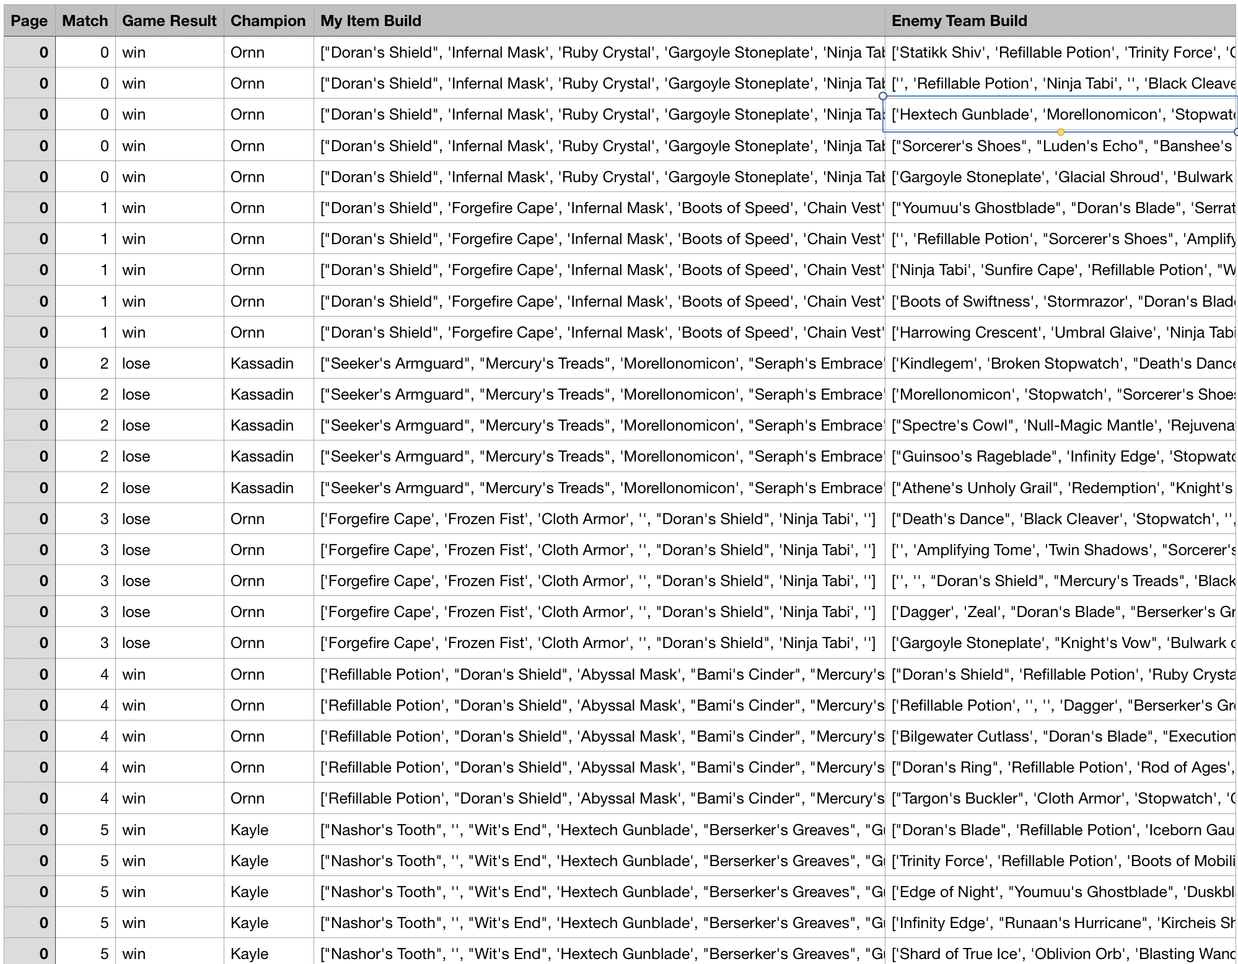

Slide 10
Logic Design
Champion Ban/Pick Tool
OCR, Pytesseract Game Window Detection
Capture pictures in the game window
Detect champions, position info… shows in the pictures
Use them as input, give pick suggestions

Slide 11
Demo
Champion Ban/Pick Tool
https://youtu.be/f6-ZWi1BwG8

Slide 12
Future Steps
In-Game Item Build Tool
Logic design (Finished)
Image detection training (Finished)
Recommendation model training (In Progress)
Frontend adjustment (Haven’t Start)
Rune Pick Tool (If we have time)
This will be a tool that can automatically pick a set of runes for our user before they get into the game (based on enemy champions)

